Slide 1
SmartPark BlockChain Project
Team Members: Kiara Mason (n11448733) Alicia Larme (n11447401)
Group number: 12

Slide 2
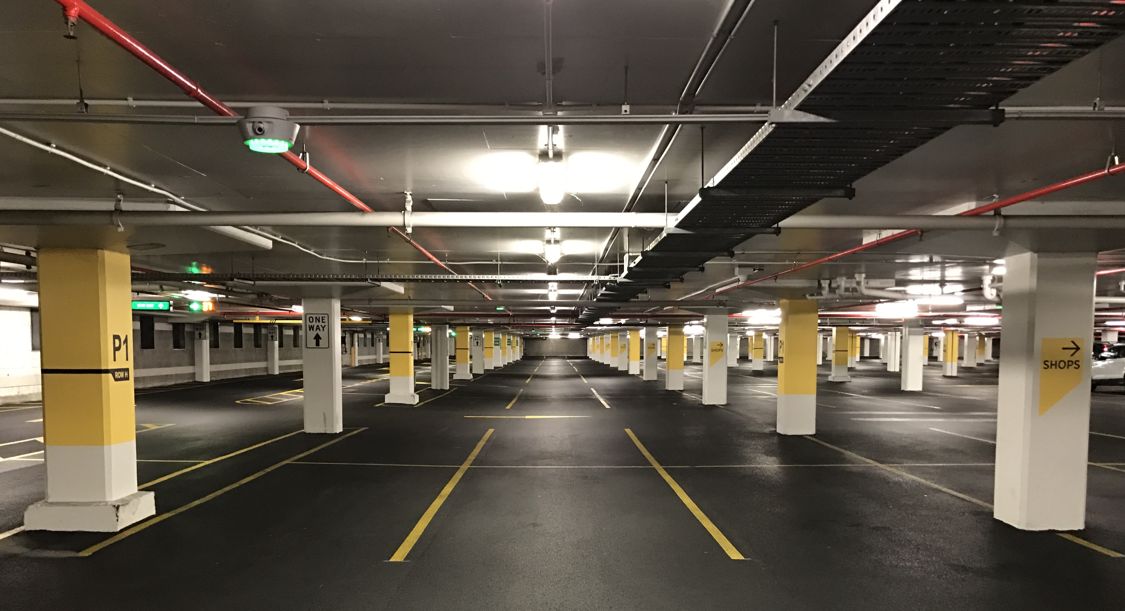
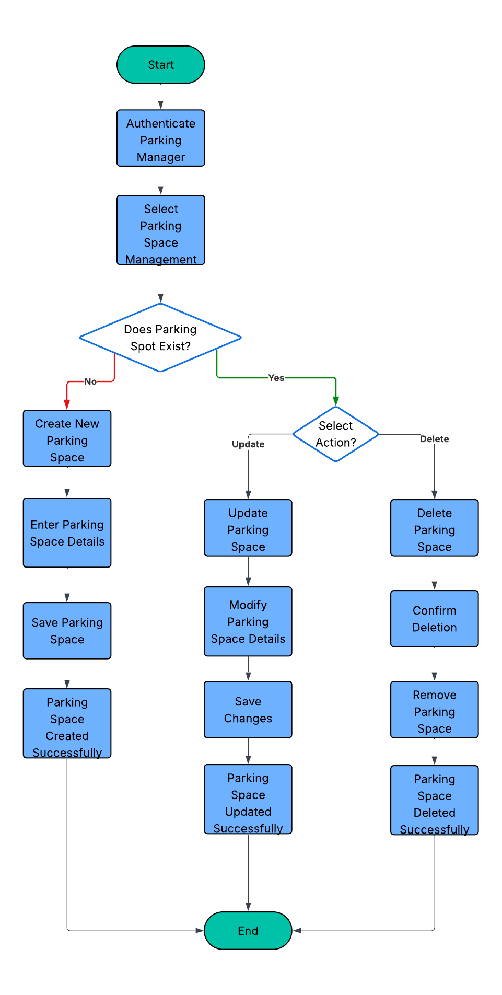
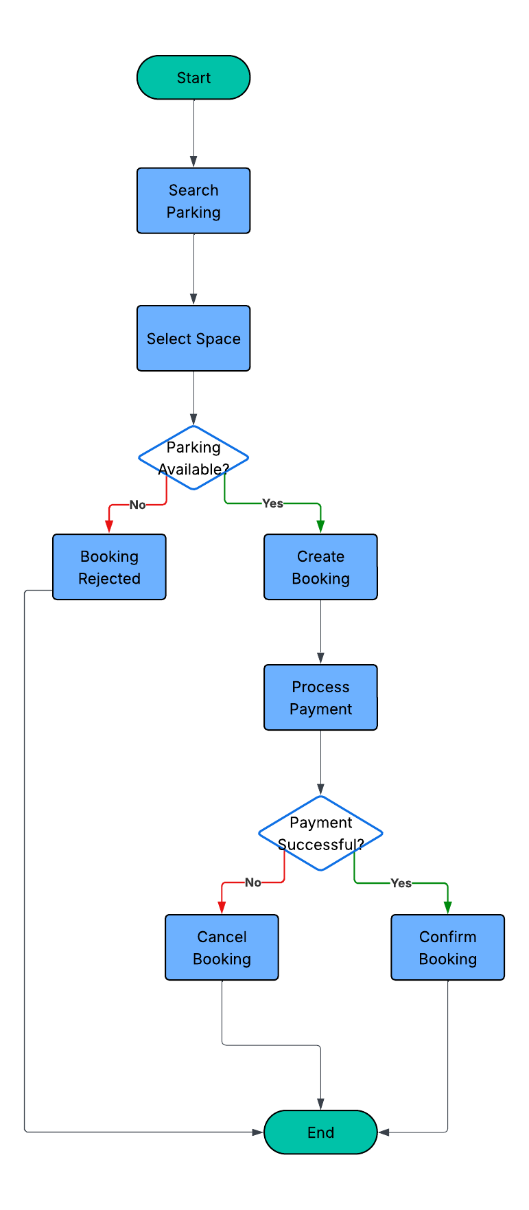
Project Overview – SmartPark
SmartPark Overview
Blockchain-based hotel parking management system
Allows users to search, book, and pay for parking spaces
Uses smart contracts to automate bookings and payments
Improves transparency, security, and trust between stakeholders
Reduces reliance on a centralised parking management system
Parking User
Parking Manager
Why Use Blockchain?
Multiple stakeholders interacting
Shared transaction records
Smart contract automation
Decentralised and transparent system
Easily trace bookings and parking spot availabilities

Slide 3


Stakeholders Smart Contracts
Parking Space Provider: Supplies, registers and manages parking spaces on the SmartPark application. Includes updating availability and pricing information.
Parking User: Searches, books and pays for parking spaces through blockchain-based booking and payment transactions.
Blockchain System: A decentralised blockchain application that validates, records and stores booking, parking and payment transactions securely through smart contracts.
ParkingSpaceManagement Contract: Manages registration and maintenance of parking spaces. Can create, update, delete and manage parking spaces availability, pricing and location
BookingAndPayment Contract: Handles the parking reservation and payment process between parking users and parking providers. Users can create, confirm, cancel, and complete bookings while securely processing payments, refunds, and payment release
Interaction: The BookingAndPayment contract interacts with the ParkingSpaceManagement contract to verify parking space availability before confirming a booking.

Slide 4
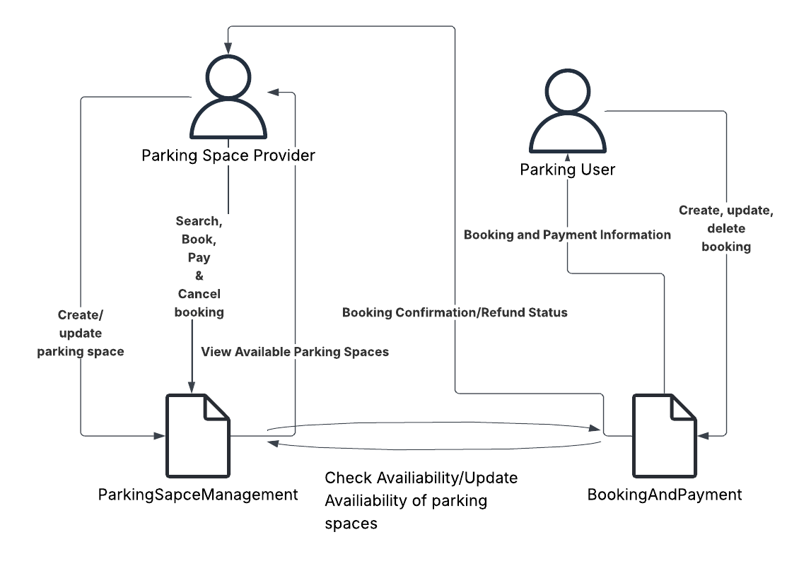
Smart Contracts Interactions
Key Interactions:
Parking Space Provider interacts with the ParkingSpaceManagement contract to create, update, and manage parking spaces.
Parking User interacts with the BookingAndPayment contract to create bookings, make payments and cancel bookings.
BookingAndPayment checks parking space availiability through ParkingSpaceManagement before confirming a booking.
Once a booking is confirmed or cancelled, the availability status is updated on the blockchain.

Slide 5
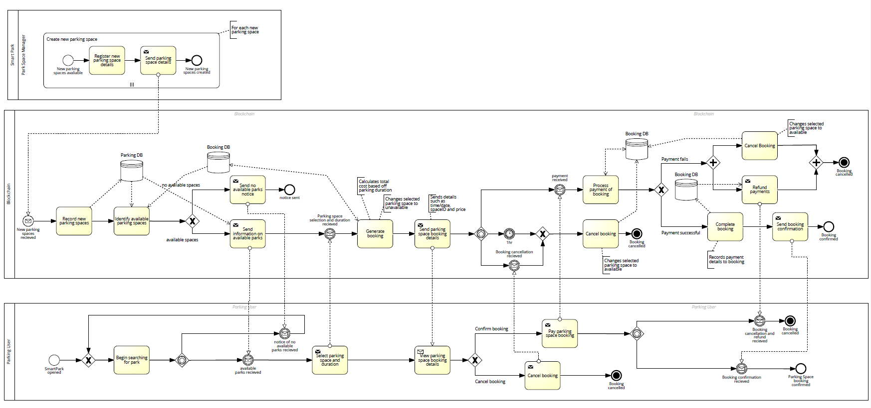
Business Process Model Specification

Slide 6
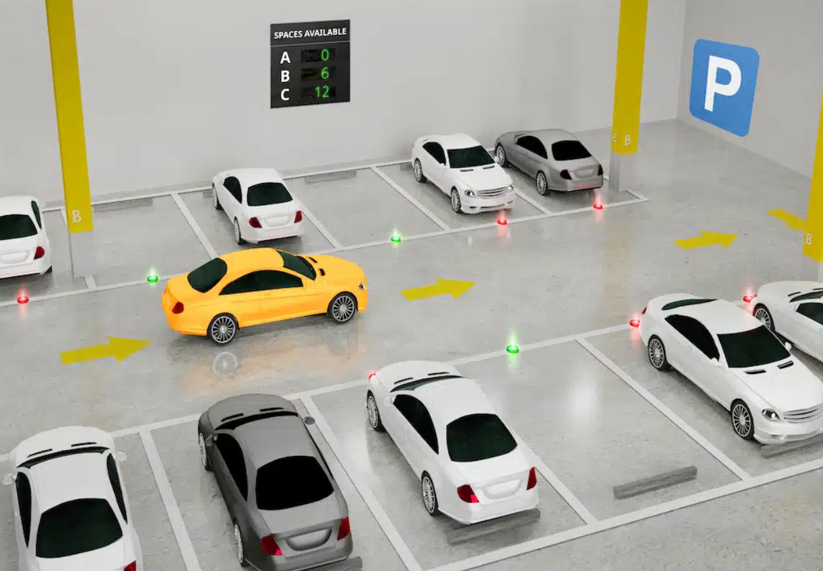
Design Considerations
Back-End Considerations
Creating parking space and booking functionality allows for two smart contracts
Role-based access – only parking manager can perform functionalities in the ParkManagement contract
Spaces are marked as available upon creation and given their own unique ID
Availability of a spot is automatically updated to false whenever a bookings are made and true when bookings are cancelled
Valiadation checks prevent inaccuracies around parking spaces, bookings or unauthoriesd updates
Challenges: Logic of system
Parking space availability is a boolean showing current state as available (True) or unavailable (False)
Prevents overlap in bookings and inaccuracies in parking availabilities
Front-End Considerations
The front-end displays only available parking spaces when selecting spaces
Simple and user-friendly interface for greater ease
Include transaction status updates so users know whether they are are pending, successful or failed

Slide 7
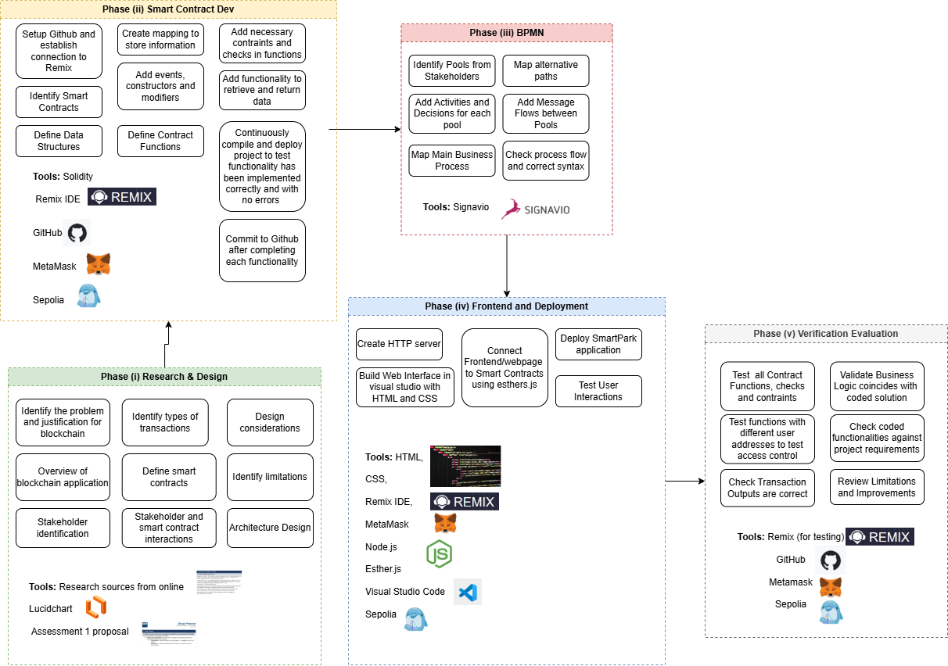
Methodology

